Slide 1
Accuracy, Precision & Recall in Machine Learning
Understanding Classification Performance Metrics
Spam Detection Example | Binary Classification

Slide 2
WHY DO WE NEED EVALUATION METRICS?
Key Points:
  Classification models predict labels (Spam / Not-Spam).
  Predictions can be correct or wrong.
  Different mistakes have different costs.
  Metrics help us measure model quality objectively.

Slide 3
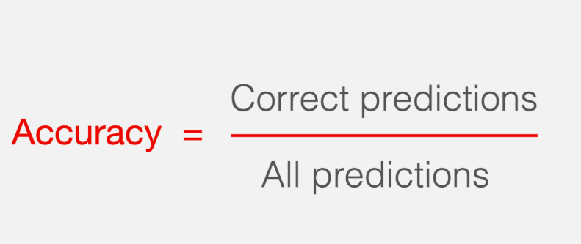
WHAT IS ACCURACY?
Definition: Accuracy measures how often a classification model is correct overall.
Simple meaning:👉 How often is the model right?
Formula:
Interpretation:
  Counts all correct predictions.
  Treats all errors equally.
  Does not distinguish error types.
Accuracy looks simple, but it does not tell us which mistakes the model makes.

Slide 4
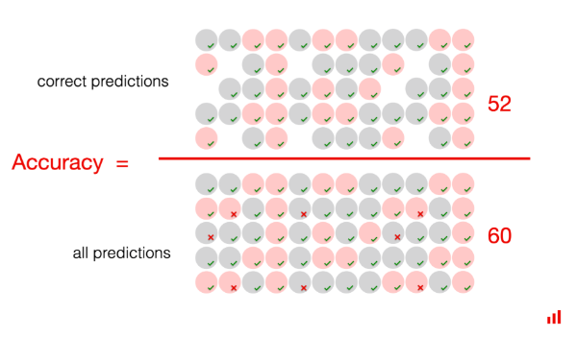
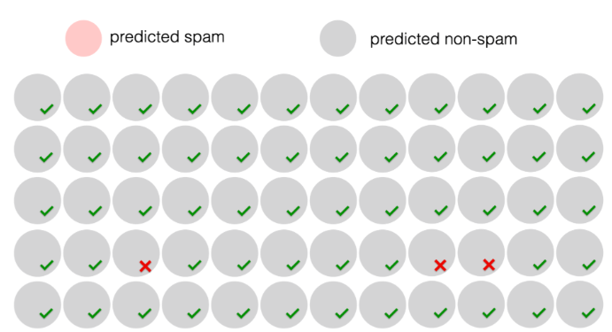
ACCURACY — EXAMPLE & ACCURACY PARADOX
Example: Accuracy Calculation
  Total emails = 60
  Correct predictions = 52
✅ The model appears to perform well.
Accuracy Paradox
  Many real-world datasets are imbalanced
  One class occurs much more frequently than the other
Example:
Only 3 spam emails out of 60
If the model predicts everything as Not Spam:
  Correct predictions = 57
  Accuracy = 95%
  Spam detected = 0
❌ High accuracy, but completely useless model
Key Takeaway (IMPORTANT)
High accuracy does NOT guarantee a good model.

Slide 5
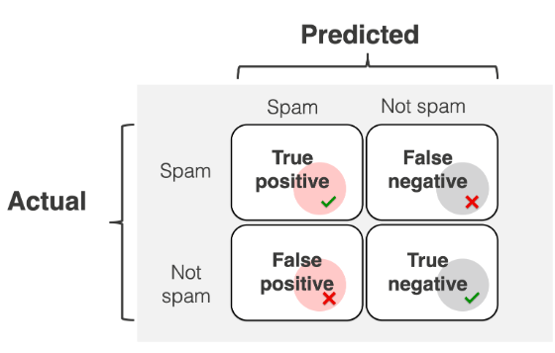
CONFUSION MATRIX
What is a Confusion Matrix? A confusion matrix summarises how a classification model makes predictions by comparing:
  Actual classes (ground truth)
  Predicted classes
It shows four key outcomes:
The Four Possible Outcomes (Confusion Matrix)
  True Positive (TP): Model predicts Spam → Email is really Spam
  False Positive (FP): Model predicts Spam → Email is NOT Spam ➝ False alarm
  True Negative (TN): Model predicts Not Spam → Email is really Not Spam
  False Negative (FN): Model predicts Not Spam → Email is actually Spam ➝ Missed positive case
Why It Matters
  Accuracy counts all correct cases
  Precision depends on TP and FP
  Recall depends on TP and FN
👉 This matrix is the foundation for all evaluation metrics.
Confusion Matrix helps us understand how mistakes happen, not just how many happen.

Slide 6
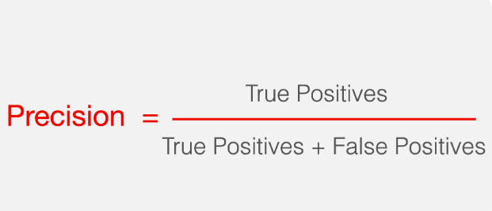
WHAT IS PRECISION?
Definition: Precision measures how often a classification model is correct when it predicts the positive class.
Simple meaning:👉 When the model says “Spam”, how often is it actually spam?
Formula:
Interpretation:
  Focuses only on positive predictions.
  Penalizes false alarms.
  Does not consider missed positive cases (false negatives).
Precision answers: “Can I trust positive predictions?”

Slide 7
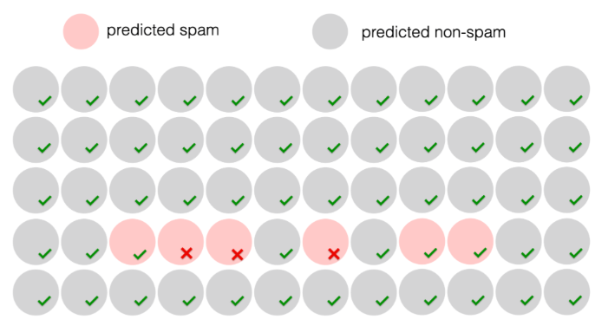
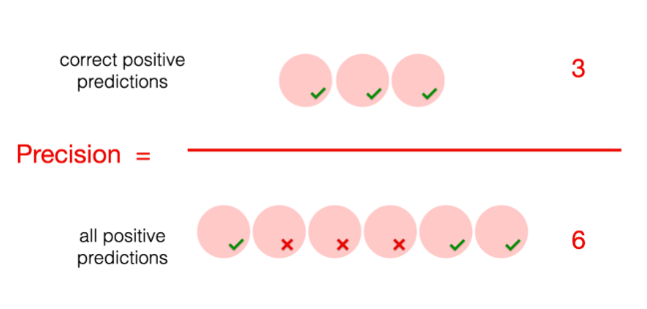
PRECISION — EXAMPLE & INTERPRETATION
Example: Precision Calculation
  Total emails = 60
  Model predicts 6 emails as Spam
Among predicted Spam emails
  ✅ True Positives (correct spam) = 3
  ❌ False Positives (not spam but predicted spam) = 3
Interpretation
  The model is correct only half the time when it predicts spam
  50% of spam predictions are false alarms
❌ High number of false positives → Low precision
Predicted spam vs predicted non-spam grid with ✔ and ✖
Precision tells us how reliable positive predictions are.
High precision = fewer false alarms ✅

Slide 8
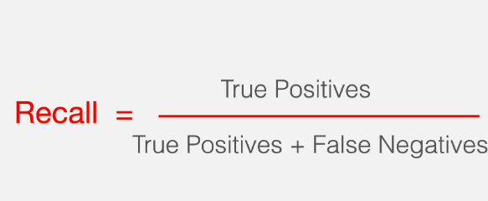
WHAT IS RECALL?
Definition: Recall measures how many actual positive cases a classification model correctly identifies.
Simple meaning:👉 Out of all real “Spam” emails, how many did the model catch?
Formula:
Interpretation:
  Focuses on actual positive cases.
  Penalizes missed positives.
  Does not consider false alarms.
Recall answers: “Did we miss anything important?”

Slide 9
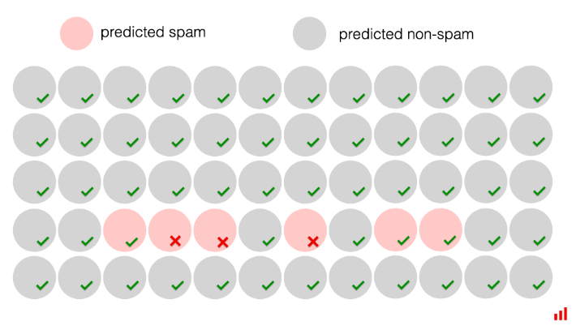
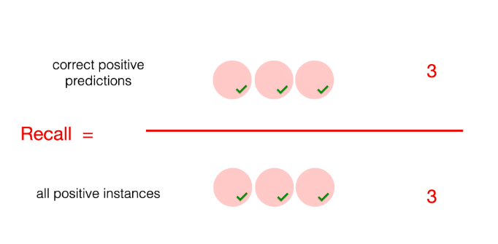
RECALL — EXAMPLE & INTERPRETATION
Example: Recall Calculation
  Total emails = 60
  Actual spam emails = 3
Model Performance
  ✅ True Positives (spam correctly detected) = 3
  ❌ False Negatives (spam missed) = 0
Recall Calculation
Interpretation
  The model detected all spam emails
  No spam was missed
  ✅ Excellent recall
⚠️ BUT…
  Some non-spam emails may still be flagged as spam
  High recall does NOT guarantee few false alarms.
High recall = no missed positives ✅
But it may increase false alarms ⚠

Slide 10
ACCURACY vs PRECISION vs RECALL (Summary)
Accuracy: How often is the model correct overall?
  Uses: TP + TN
  Ignores: Which type of mistake happened
  Best when classes are balanced
Precision: When the model predicts Positive, how often is it correct?
  Uses: TP and FP
  Penalises: False Positives (false alarms)
  Answers: “Can I trust positive predictions?”
Recall: Out of all actual Positive cases, how many did we detect?
  Uses: TP and FN
  Penalises: False Negatives (missed positives)
  Answers: “Did we miss anything important?”
Accuracy tells how many predictions are correct overall.
Precision tells how reliable positive predictions are.
Recall tells how many real positives we detected.
No single metric is enough — choose based on the problem.

